Slide 1
HAPPY NEW YEAR
GICF RETREAT
‘GREAT THINGS’
This Saturday, January 12th
Sign up today (10 RMB per head)

Slide 2
LOOK TO JESUS

Slide 3
Year Theme and first sermon series Hebrews 11 & 12
1. Therefore we also, since we are surrounded by so great a cloud of witnesses, let us lay aside every weight, and the sin which so easily ensnares us, and let us run with endurance the race that is set before us, ² looking unto Jesus, the author and finisher of our faith, who for the joy that was set before Him endured the cross, despising the shame, and has sat down at the right hand of the throne of God.

Slide 4
To whom are you looking?
Who is Jesus in your mind?
Notes:
Look TO not look AT. Look for what?

Slide 5
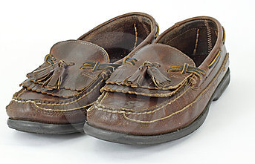
OLD SHOES
Isaiah 30:15 In returning & rest you shall be saved; In quietness and confidence shall be your strength.
1 Samuel 30:6 But David strengthened himself in the LORD his God.
Philippians 2:1-3 Therefore if there is any consolation in Christ, if any comfort of love, if any fellowship of the Spirit, if any affection and mercy, fulfill my joy by being like-minded, having the same love, …
John 17:3 And this is eternal life, that they may know You, the only true God, and Jesus Christ whom You have sent.
Philippians 3:10 that I may know Him and the power of His resurrection,
Job 33:26 He shall pray to God, and He will delight in him, He shall see His face with joy, For He restores to man His righteousness.
Psalm 46:10 Be still, and know that I am God;
Job 29:4 Just as I was in the days of my prime, When the friendly counsel of God was over my tent;
Proverbs 3:32 His (God’s) secret counsel is with the upright.
Find comfort in knowing God and being around Him
Notes:
Women and high heals! My shoe collection (3 pairs). Encamotado con un par.

Slide 6
JESUS MUSIC
Give God time to talk to you!
Notes:
Secular vs Christian music

Slide 7
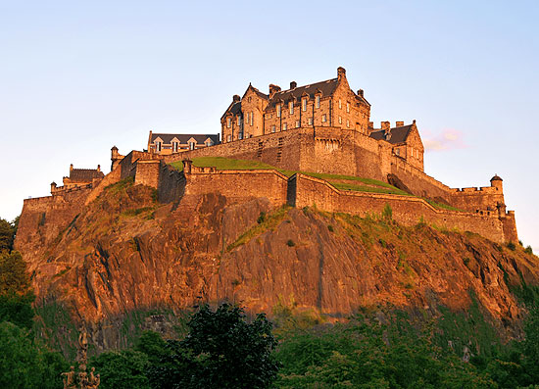
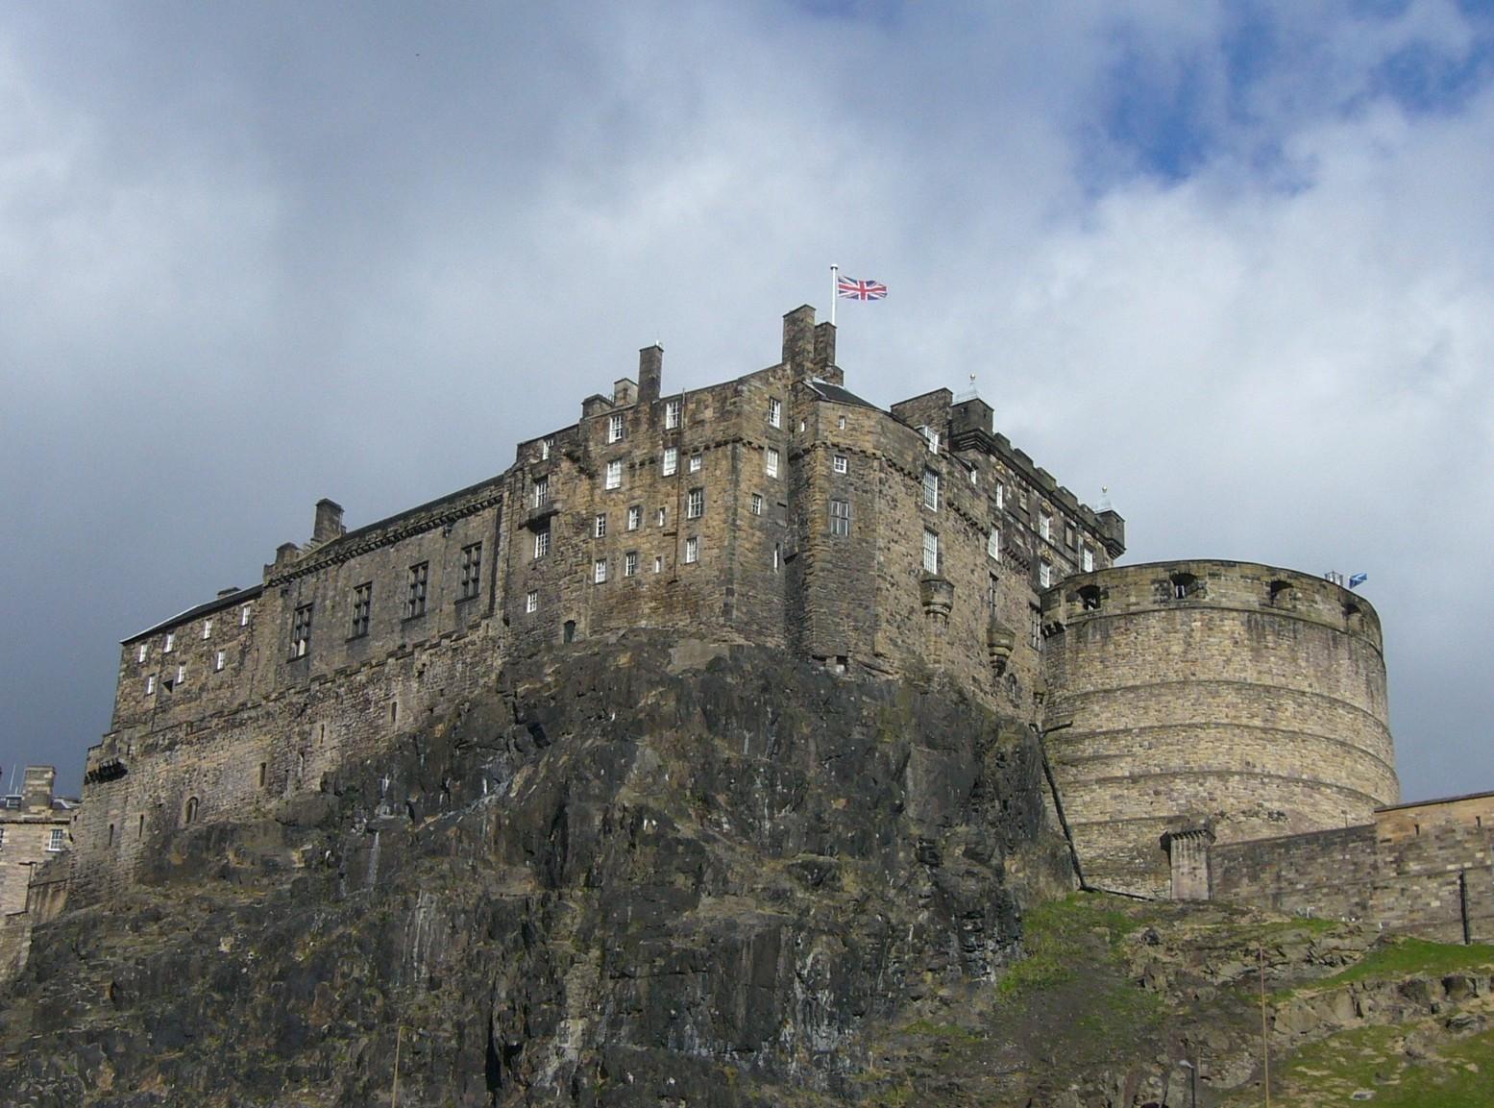
Scottish Castles
Safe refuge
Strong Tower
Notes:
An Englishman's house is his castle. (And a Scotsman’s too!)

Slide 8
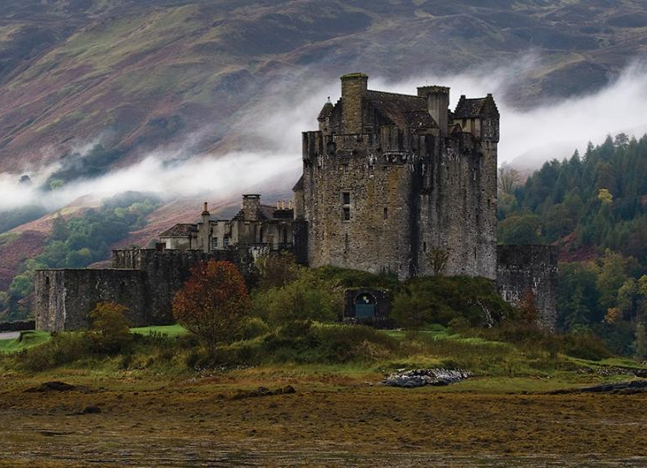
Shelter from the storm

Slide 9
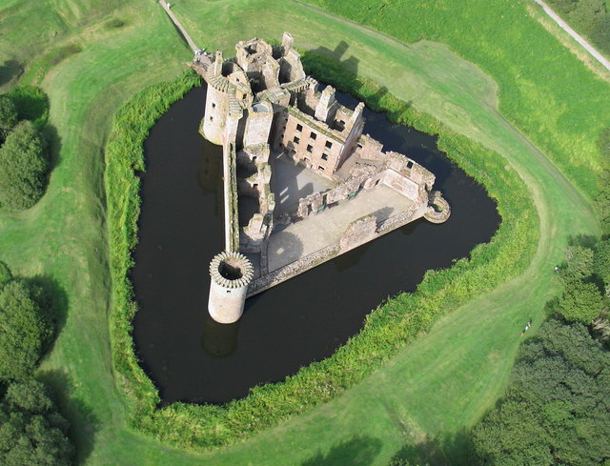
Mighty Fortress

Slide 10
Christ the Castle
Psalm 61:3-4
³ For You have been a shelter for me, A strong tower from the enemy. ⁴ I will abide in Your tabernacle forever; I will trust in the shelter of Your wings. Selah
Proverbs 18:10 The name of the LORD is a strong tower;
The righteous run to it and are safe.‘
Run to Salvation Castle. Live there always.
What does your heart think of Christ? “I love you, Jesus”

Slide 11
Making the List (Getting on the Hebrews 11 list)
^{…33} Who through faith subdued kingdoms, …stopped the mouths of lions. … They were stoned, they were sawn asunder, were tempted, … ³⁸ (Of whom the world was not worthy:) they wandered in deserts, and in mountains, and in dens and caves of the earth.
³⁹ And these all, having obtained a good report through faith, did not receive (died without receiving) the promise:
What did Abraham, Isaac, Jacob and the rest ever build or achieve? Mostly just hanging on in faith. SO, JUST HANG ON!
Notes:
Faithful in daily life (love Jesus and others)
Faithful in fulfilling God’s plan – whether ‘big’ or ‘small’.

Slide 12
Last Year’s Theme Message Authentic Christian Living
By December 31, 2012, will you have done what God had in mind for you?
How did you do? Did you meet His goals and find His path for your life?

Slide 13
This Year’s Theme - Looking to Jesus Heb 12:1-2
Therefore we also, since we are surrounded by so great a cloud of witnesses,
let us lay aside every weight, and the sin which so easily ensnares us, and
let us run with endurance the race that is set before us,
looking unto Jesus, the author & finisher of our faith, who for the joy that was set before Him endured the cross, despising the shame, and has sat down at the right hand of the throne of God.

Slide 14
Hebrews 2:1-16
Lay aside the sin – there are always witnesses!
Run with endurance (patience, perseverance) – just hang on!
Looking to Jesus (who suffered … for the joy – having all his brothers and sister come to his wedding! ) gives us purpose in life.

Slide 15
CONCLUSION - looking to Jesus:
I live in Salvation Castle (& am comfortable staying in his house)
ARE YOU?
2. I am laying aside sin (there are witnesses around)
ARE YOU?
3. I am seeking my life purpose only in Him
ARE YOU?
4. I am willing to pay the price and just HANG ON.
ARE YOU?
Notes:
Faith is just hanging in there. Faith without perseverance just gives up. Faith needs works to stay alive!

Slide 16
Question of the year: Are you …
Looking to Jesus
… for salvation, protection, and life purpose?

